Slide 1
Posting temporary workers to the Netherlands
Arjan de Klerk, Deputy Head of Division, Terms of Employment and Labour Migration Division
Adriana Kerkstra, Policy Adviser, Terms of Employment and Labour Migration Division

Slide 2
Contents
1.
Introductory remarks
2.
Terms of employment
3.
The notification duty
4.
Case study

Slide 3
1. Introductory remarks
Foreign workers in the Netherlands
Temporary employment agencies (TWA)
Abuse and exploitation – new rules for TWA
Posting of third country nationals

Slide 4
2. Terms of employment
Terms of Employment Posted Workers in the EU Act + Waadi Act
Principle 1: Equal pay for equal work
Additional rights for posted temporary workers
Terms of employment should be identical to Dutch counterparts
Principle 2: Employer remains responsible

Slide 5
2. Terms of employment
Administrative requirements
Register with Dutch Chamber of Commerce on kvk.nl/en
Posting notification duty
Documents at workplace
Posting third country nationals
More information on english.postedworkers.nl and workinnl.nl

Slide 6
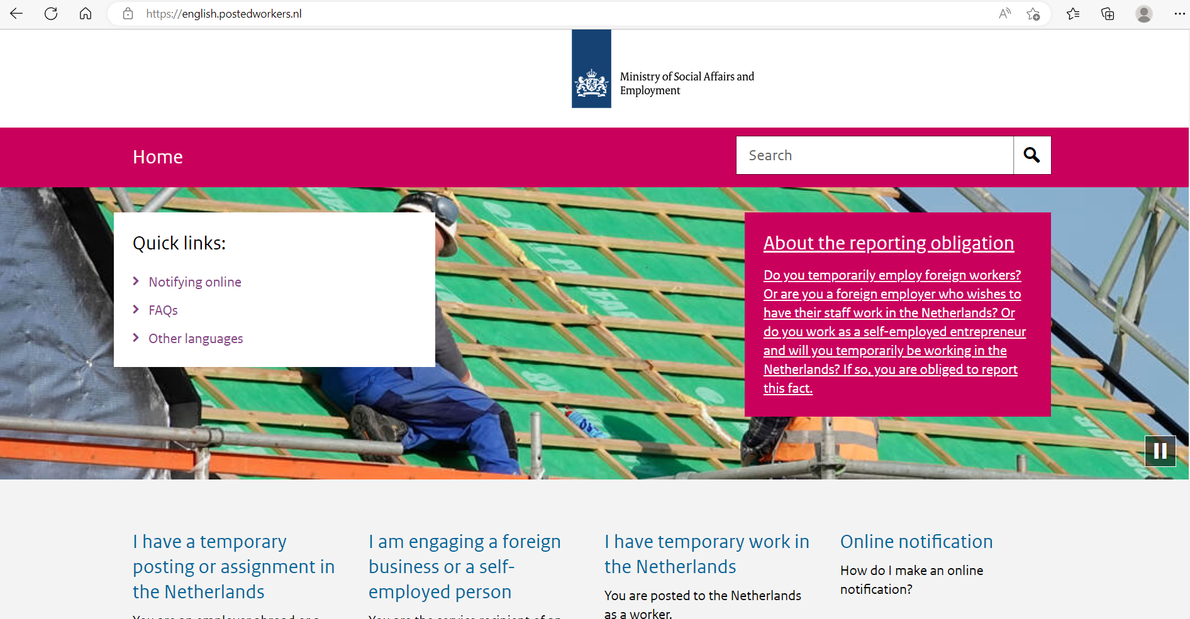
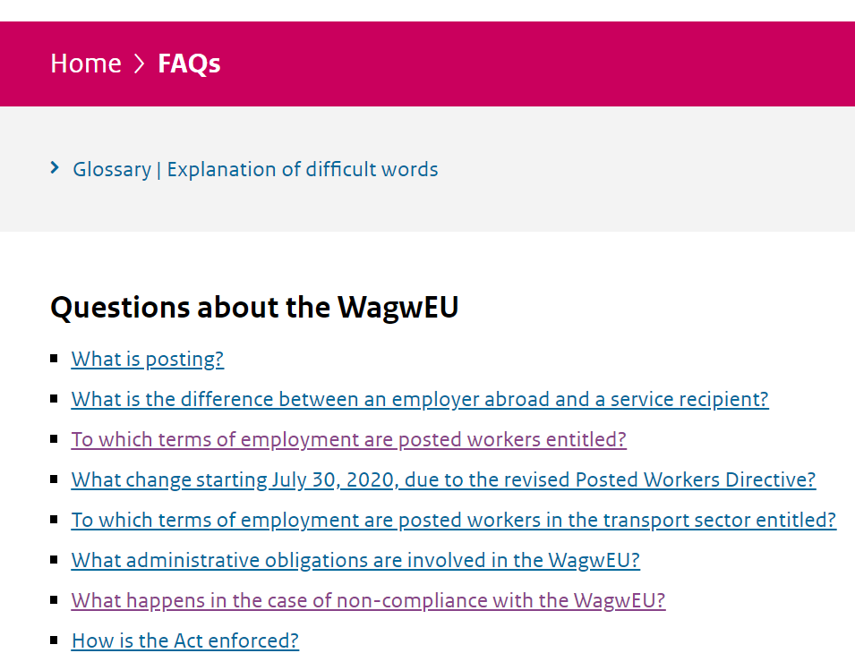
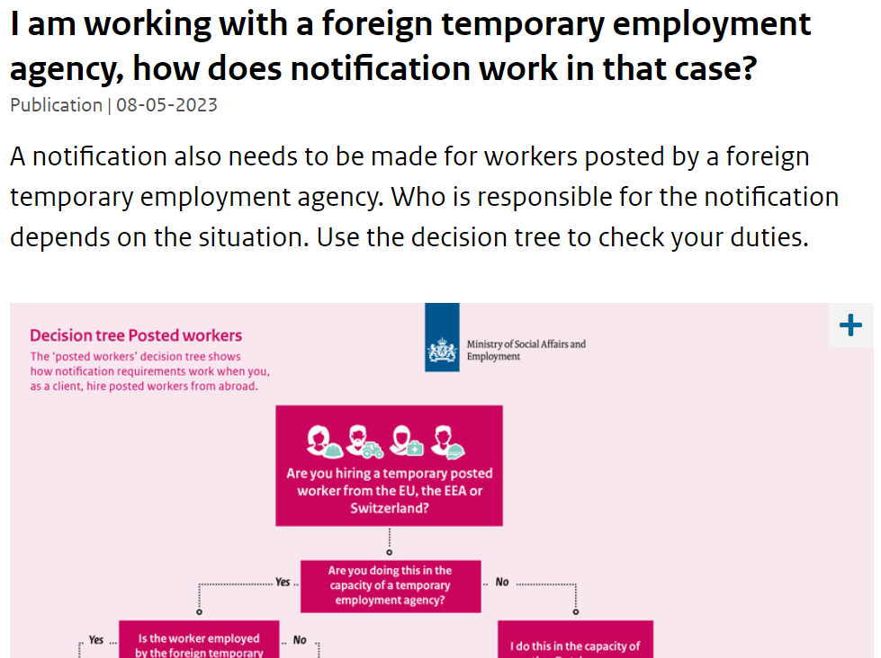

Slide 7
3. The notification duty
Prepare
Find the checklist on the factsheet from postedworkers.nl
Submit (before posting starts)
Portal: meldloket.postedworkers.nl

Slide 8
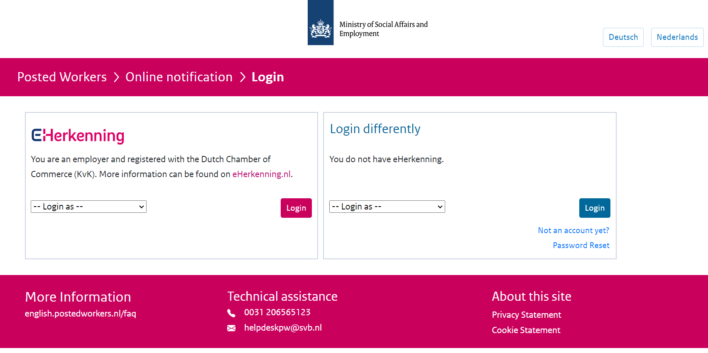

Slide 9
3. The notification duty
Prepare
Find the checklist on the factsheet from postedworkers.nl
Submit (before posting starts)
Portal: meldloket.postedworkers.nl
Check (by Dutch client)
! Use correct email address
If necessary, change the notification
! Report changes
E.g. if posting takes longer
E.g. if workers are sent on to different service recipient

Slide 10
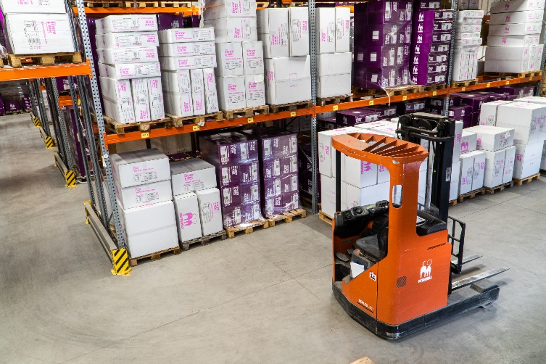
4. Case study
TWA Inc.
Kersen B.V.

Slide 11
Contact client about terms of employment
Inform your employees
Register and notify
Ensure right terms of employment Update notification Keep documents at the workplace

Slide 12
Thank you for your attention
Please do get in touch if you have any questions
Arjan de Klerk jdklerk@minszw.nl
Adriana Kerkstra akerkstra@minszw.nl
english.postedworkers.nl // workinnl.nl

